Slide 1
Data Science and Other Buzzwords You Should Know
OA 1600
Sam Buttrey
Naval Postgraduate School
September 2023

Slide 2
Who Am I?
Prof. Sam Buttrey, buttrey@nps.edu
A.B., Princeton, Statistics; M.A., Ph.D., U. California-Berkeley, Statistics
Naval Postgraduate School, Department of Operations Research, 1996-Present
Interests: Data Analysis, Big Data Analytics and Computing, Classification, Modeling and Applications

Slide 3
Disclaimer
These thoughts are just my opinions
Not those of the US Government, the DoD, the US Navy, NPS, NPS OR, CDR Cohick…
They’re subject to change in the face of new information, or a reconsideration of old information

Slide 4
Agenda
What are some of the data-related buzzwords floating around, and what do I think they mean?
A few stories of interesting OR projects and/or theses I’ve been involved in
Brief nap (back rows only)
Call it a day

Slide 5
Operations Research
“The Science of BetterSM”
“Pillars” include:
Optimization, Network Analysis
Probability, Statistics, Data Analysis
Stochastic Models, Queuing Theory
Simulation
Logistics
Decision Analysis
Human Factors …. And more

Slide 6
Prob, Stats, Data Analysis
Probability: given a mathematical model for data production, what sorts of output data would we expect?
Statistics: given some data, what sorts of mathematical models are plausible for its production?
If some assumptions are met we can perform inference – hypothesis tests, confidence intervals – and, at least in theory, learn stuff

Slide 7
Classical Data Analysis
Classical Data Analysis is very often intended to perform inference (e.g. linear and logistic regression)
Exploratory Data Analysis – but “don’t form your hypotheses after looking at your data”
Data of moderate size
Inference (“Confirmatory Data Analysis”) is a statement about a population based on data from just a sample, one taken with some probability method

Slide 8
More Buzzwords
Data Analysis/Analytics
Data Science
Big Data
Data Engineering
Remote and Distributed Computing
Machine Learning
Artificial Intelligence
“Deep Learning” and neural networks
“Operational Data Science and Statistical Machine Learning” (268 Certificate)

Slide 9
Data Preparation
Modern data sets might have millions of rows and thousands of columns
Numeric, categorical, free text, date/time, geographic (lat/long/alt), NA codes…
There are always issues with missing or erroneous data, duplicate or overlapping columns, heterogeneous sources, heterogeneous formats (dates, European decimal points), match keys, and so on
ZIP, text, XML, JSON, XLSX, DBMS, …
Anything you do should be reproducible

Slide 10
Data Preparation, cont’d
A crucial part of any project
Iterative: you will come back to data prep after the analysis begins
Remember: reproducibility is critical!
There “should” be a complete and up-to-date “data dictionary,” but good luck
You can’t do data prep without understanding at least a little about the underlying business problem

Slide 11
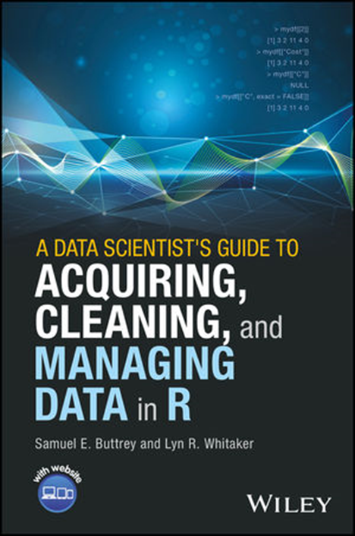
Shameless Plug
“Data science” was a collateral duty of statisticians and analysts, separate from the “real” work
There is no “Journal of Data Cleaning”
We estimate that 80% of the time in any statistical analysis is spend acquiring, cleaning and managing data…
…So maybe we should spend 80% of our resources and training on handling data…
But we don’t

Slide 12
Dealing With The Sponsor
It sounds weird, but surprisingly often our sponsor’s question is, “here’s a bunch of data I collected; what does it tell me”?
It’s all the data they have; no sampling
It’s large and messy
They may not know much about it
One of your jobs as analyst is to try to figure out what the clients need, which is often different from what they say they need

Slide 13
More Buzzwords (again)
Data Analysis/Analytics
Data Science
Big Data
Data Engineering
Remote and Distributed Computing
Machine Learning
Artificial Intelligence
“Deep Learning” and neural networks
“Operational Data Science and Statistical Machine Learning” (268 Certificate)

Slide 14
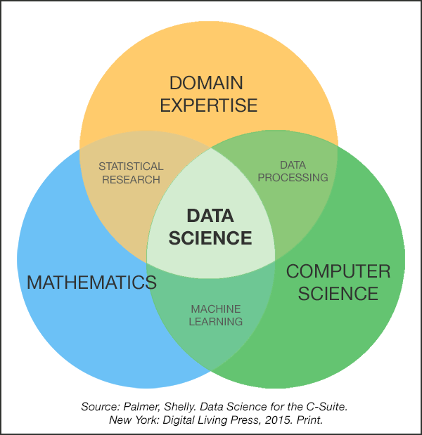
Data Science vis-à-vis Statistics
Domain Expertise Competencies
Specific functional area
Curious about data
Influence with leaders
Problem solver
Make narratives w/data
Visual design and communication
Creative, innovative, and collaborative
Math and Statistics Competencies
Statistical modeling
Machine learning
Bayesian inference
Optimization
Simulation
Network science
Model development
Computer Science Competencies
Scripting (Python)
Statistical computing (R)
Databases (No/SQL)
Distributed storage (Hadoop Distributed FS)
Distributed processing (MapReduce)
Cloud computing (AWS) Data pipelines (Pig/Hive)
Data Science is a team sport!

Slide 15
More Buzzwords (again)
Data Analysis/Analytics
Data Science
Big Data
Data Engineering
Remote and Distributed Computing
Machine Learning
Artificial Intelligence
“Deep Learning” and neural networks
“Operational Data Science and Statistical Machine Learning” (268 Certificate)

Slide 16
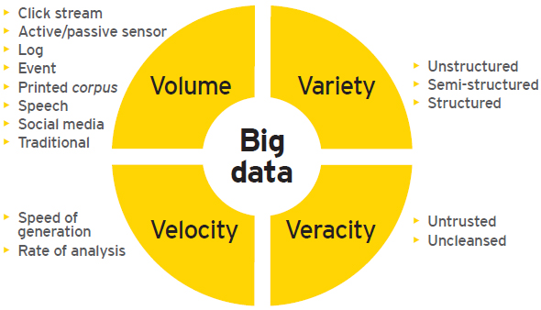
Big Data: The 3? 4? 5? V’s
Big Data is any data that breaks your workflow or can’t be used…
But amalgamating data can give you new information, too

Slide 17
Data Engineering
This can refer to the acquiring, cleaning, managing (+ archiving) process, but it can also mean overseeing the infrastructure for big data analysis
Design, implementation and management of...
Relational databases
Other “big data” storage solutions
Remote and distributed computing platforms (e.g. Hadoop, cloud systems)
These are CS/IS issues (but see OA 3802)

Slide 18
More Buzzwords (again)
Data Analysis/Analytics
Data Science
Big Data
Data Engineering
Remote and Distributed Computing
Machine Learning
Artificial Intelligence
“Deep Learning” and neural networks
“Operational Data Science and Statistical Machine Learning” (268 Certificate)

Slide 19
Machine Learning
Machine Learning is just data analysis that is mostly automatic
Important point: feature selection
Still possible to add value manually
The goal is not inference but just prediction of new data (from the same source as the old)
If there is a known “response” variable(s) we’re trying to predict, we call it supervised, else unsupervised
You still have to understand the problem!

Slide 20
Artificial Intelligence
AI is Machine Learning in real time
Includes supervised, unsupervised and “reinforcement learning”
Example: self-driving car
The hottest buzzword of all, because it sounds as if it can answer all our problems

Slide 21
Artificial Intelligence
AI is Machine Learning in real time
Includes supervised, unsupervised and “reinforcement learning”
Example: self-driving car
The hottest buzzword of all, because it sounds as if it can answer all our problems
It can’t
P.S. As with ML, no inference; we just trust that something will keep working

Slide 22
“Deep Learning”
A neural network is a particular (complicated) statistical model useful for regression and classification
There are unsupervised applications too
A neural network has “layers” and one with a lot of layers is said to be “deep,” hence “deep learning”
It sounds like “esoteric philosophy”

Slide 23
“Deep Learning”
A neural network is a particular (complicated) statistical model useful for regression and classification
There are unsupervised applications too
A neural network has “layers” and one with a lot of layers is said to be “deep,” hence “deep learning”
It sounds like “esoteric philosophy”
It’s not

Slide 24
The Final Buzzword
The 269 Certificate is in “Operational Data Science and Statistical Machine Learning”
A name drawn up by a committee in the face of political pushback from the CS department

Slide 25
Beware of…
“Qualitative analysis” – what is this? Focus groups? Interviews with “subject matter experts”? How can I use this? When, and to what extent?
SMEs may know more than you, but they often know less than they think
People who say “they just want to look at the data they have; they don’t want to extrapolate to future data.” I think they’re fooling themselves

Slide 26
What Can ML Not Do?
Operate independently of data collection and pre-processing
Magically determine a solution to a business problem – or the problem
Move ahead without understanding both the data and the context
Glean more information that there is in the data – GIGO
Communicate results to sponsors, peers, thesis advisors, journal editors

Slide 27
Part 2: Some Neat Problems
Prof. Craparo has a bunch of data on electrical usage at FOBs
If each generator were equipped with a storage system (e.g. battery), what would be the optimal regime of generator/battery power supply to minimize cost?
Answer: it depends on the demand, which is unknown…but we can model it
Data Analysis + optimization

Slide 28
Neat Problem #2
Prof. Salmeron wants to place Army recruiting stations in the most efficient places
But to do that he has to estimate how many recruits we can expect from each region (say, ZIP code) based on demographics, past history, availability of colleges and universities…
Data Analysis + optimization

Slide 29
Neat Problem #3
Naval Aviation has data interpolated every 10 seconds on ~400,000 F/A-18 sorties
~157 million records from on-board sensors, plus pilot-based sortie information
Lots of missing data, definitely not random
Question: “We paid a company to produce a ‘dashboard’ to look at this data. Was that a good move?”
Us: “Well, what are you planning to use it for?”

Slide 30
Neat Problem #4
AIS data from ship transponders
Analogous to “blue force tracker”
The Coast Guard has a data set with over a trillion AIS hits…with noise, missing, etc.
General question: what ships are behaving in unexpected ways?
Not counting “teleporting to Algeria”
Blue force tracker: which vehicles went on patrols together?
Here “big data” can give us information beyond what it was designed for

Slide 31
Neat Problem #5
“Pulling the goalie” in ice hockey
Earlier work assumed constant scoring rates for all teams in all situations
Computing problem: assemble all the boxscores from all the games (~1300/year)
Statistics problem: Can we predict the outcome of games? What models are needed? (Scoring rates, penalty rates)
OR problem: When to pull the goalie?

Slide 32
Conclusion
There is a broad set of tools needed to acquire/clean/manage data, build models, draw conclusions
These come from the disciplines of CS/IS, Statistics and OR, and from domain knowledge
Final skill needed: communication
If you can’t write down and defend your conclusions, your analysis is worth less (with a space, or maybe without)

