Slide 1
Introduction to Simulink
Matlab based
Both Continuous Time and Discrete Time Simulation
Based on Blocksets
Model Based Design: a software model of the environment can be developed and the design can be tested by simulation
Transition between “ideal” algorithms (infinite precision, floating point) to “real world” algorithms (finite precision, fixed point);
Automatic Code Generation: once the design is tested and validated, real time code can be automatically generated for the target platform
Continuous Test and Verification

Slide 2
Advantages (from the MathWorks slide)
Innovation
Rapid design iterations
“What-if” studies
Unique features and differentiators
Quality
Reduce design errors
Minimize hand coding errors
Unambiguous communication internally and externally
Cost
Reduce expensive physical prototypes
Reduce re-work
Reduce testing
Time-to-market
Get it right the first time

Slide 3
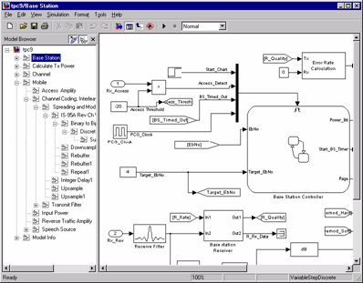
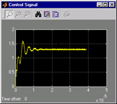
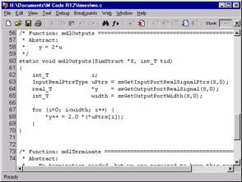
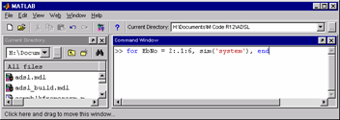
Simulink
Hierarchical block diagram design and simulation tool
Built-in notions of time and concurrency
Digital, analog/mixed signal and event driven
Visualize Signals
Co-develop with C code
Integrated with MATLAB

Slide 4
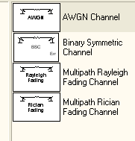
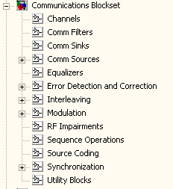
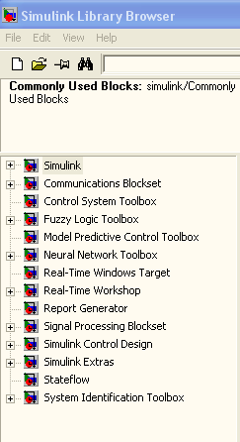
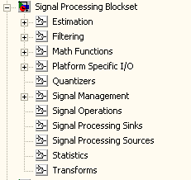
Simulink has a very rich library of blocksets:

