Slide 1
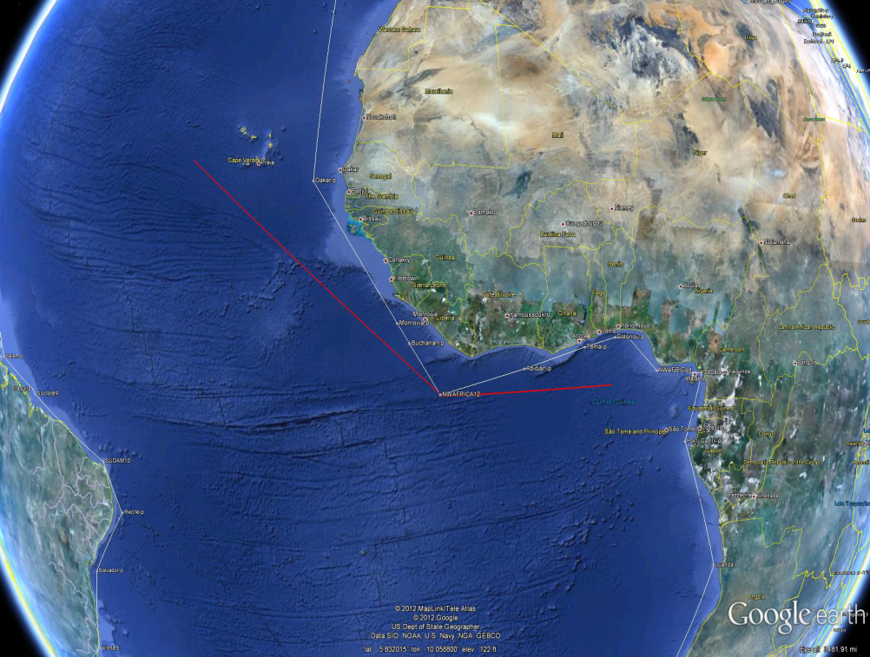
Oceanic Shortest Routes
Al Washburn
80th MORS, 2012
Anton Rowe, Jerry Brown, Wilson Price
Notes:
4
4
4
4
4
4

Slide 2
Underway Replenishment
A Traveling Salesman problem where the cities keep moving around on the surface of a sphere, the subject of RASP.
Here we deal with a relatively simple, embedded subproblem:
How long will it take to get from X to Y?
  We assume at constant speed, so time is not involved
  A simple problem, were it not for various obstacles
Notes:
4
4
4
4
4
4

Slide 3
Consider two approximation methods
Put some kind of a finite grid on the ocean, periodically calculate all shortest routes, store them, and look them up as needed.
  Move X and Y to the nearest stored points
  Consider winds, currents, hurricanes, etc. when defining “distance”
  Suffer from inaccuracies due to finite grid
Don’t grid the ocean, and face the fact that routing calculations cannot be completed until X and Y are known.
  A different kind of approximation (symmetric shortest path)
  Suffer because “distance” will have to be geometric
  The subject of this talk
Notes:
4
4
4
4
4
4

Slide 4
Obstacles
Landmasses such as America and Cyprus
  41 in our current database
Each described by a clockwise “connect the dots” exercise (a spherical polygon)
  The dots are called “vertexes”
  The connecting arcs are called “segments”
    Great circle fragments with length < π Earth radii
Notes:
4
4
4
4
4
4

Slide 5
An interesting and useful fact about Earth
Every contiguous land mass will fit in a hemisphere
  Even EurAfrica before the Suez Canal
  Thank heavens the Asia-America connection is now wet!
Therefore every obstacle has a convex hull
  Half of a baseball cover will not fit in a hemisphere, and therefore does not have a convex hull, but luckily Earth does not have any such obstacles
  However, many obstacles on Earth are not convex
Notes:
4
4
4
4
4
4

Slide 6
Observation
The shortest path will either go directly from X to Y, or, if X cannot “see” Y because of some intervening obstacle, the shortest path will go from X to some vertex i that is visible from X, then from i to some vertex j (the two vertexes might be the same), etc., and then finally from j to Y that is visible from j.
Notes:
4
4
4
4
4
4

Slide 7
Therefore …
Step 1: Compute and store the shortest distances (d_{ij}) from vertex i to vertex j, for all i and j
  These are the “static” computations, and can therefore take lots of time (~1000 vertexes)
Step 2: Once X and Y are known, determine which vertexes are visible from X and from Y
  If Y is visible from X, the shortest route is direct, so quit
Step 3: for all feasible pairs (i,j) sum three distances and then choose the minimum (brute force)
  Steps 2 and 3 are the “dynamic” computations, which must be fast
Notes:
4
4
4
4
4
4

Slide 8
Visibility
Static and dynamic computations both depend on first establishing visibility
  A symmetric relationship between X and Y
  Usually obvious to a human eyeball viewing Earth
  Nontrivial analytically, and the core of the problem
We have tested two analytic methods for determining visibility: the segment intersection (SI) method and the Border method
Notes:
4
4
4
4
4
4

Slide 9
Visibility (SI method)
If X and Y are both “wet”, then X can see Y if and only if the (minimal) great circle segment connecting X to Y intersects no segment defining the border of any obstacle
  Also true if X and Y are vertexes, provided one is careful about the meaning of “intersect”
  One can gamble and test for an intersection with the obstacle’s convex hull
  Every pair (X,Y) requires an independent visibility calculation (1000x1000x1000 static intersection tests if there are 1000 vertexes)
Notes:
4
4
4
4
4
4

Slide 10
The Border method
Every point X has a “Border” that amounts to partitioning a circle about X into “wedges” wherein a ray from X will first encounter a certain controlling “chain” that is a continuous part of the border of some obstacle
Given the border of X, testing visibility to Y amounts to finding the bearing of Y from X, and then testing whether the distance to Y is smaller than the distance to the controlling chain or not
Notes:
4
4
4
4
4
4

Slide 11
Border with four Obstacles

Slide 12
An obstacle and its chains
X is at the origin, each chain goes + to -
A

Slide 13
Spherical Topology
As a ray from X sweeps clockwise completely around the border of an obstacle, the angle A will increase by an amount B
  In Euclidean 2-D, B will be
    0 if X is outside the obstacle
    2π if X is inside the obstacle
    Related to “winding numbers”
    Useful in deciding whether X is wet or dry
  On the surface of a sphere, B can also be
    - 2π if the antipode of X is inside the obstacle

Slide 14
Finding the border of X
Cursor moves counterclockwise through 2π, whisker follows cursor
whisker
cursor
X

Slide 15
SI versus Border
SI is a medium length computation, repeated for every pair (X,Y)
Border is a longer length computation, repeated for every X
  The border of X determines visibility to all vertexes, as well as any other point Y
Border wins by an order of magnitude
  Especially if X and Y are actually sets of points at which one might start or end

Slide 16
Shortest path summary
Use the Border method to determine vertex-to-vertex visibility
Determine shortest distances among vertexes
  Consider Floyd-Warshall
Once X and Y are determined, use the Border method to determine point-to-point and point-to-vertex visibility
  Exit if X can see Y
Use brute force on visible (i,j) pairs to find the best route from X to Y

Slide 17
An unexpected “byproduct” of our work
  A Navy ship can currently find an optimal route from X to Y only by first sending a message to a Fleet Weather Center
  It would therefore be useful to have a simple, web-based procedure for finding an optimal route.
  Let’s call it Oceanic Route Finder!

Slide 18
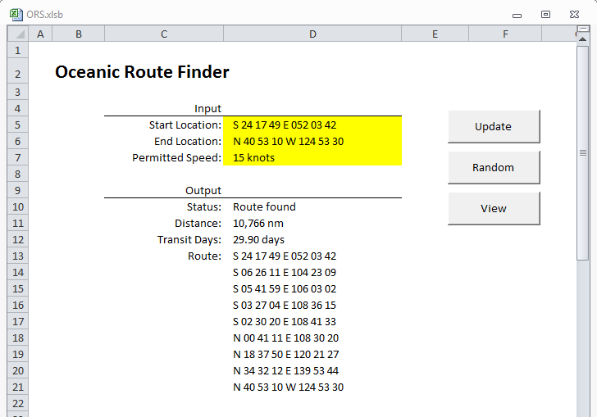
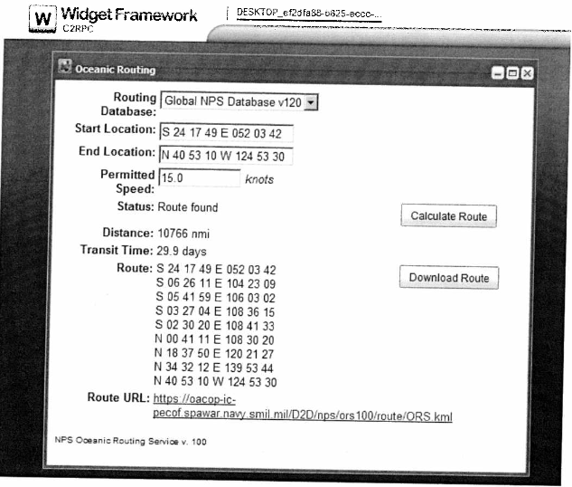
NPS Development Complete
February 2012
Available in C2RPC
April 2012

Slide 19
