Slide 1
Humanitarian Assistance & Disaster Response (HADR) Experimentation Concept
Technology Experimentation and Training integrated into
Humanitarian Civic Action (HCA) events
POC: Scott Hourin
MARFORPAC
Experimentation Center (MEC)
scott.hourin@usmc.mil | 808.268.0468

Slide 2
Reference: Joint Pub 3-29
Humanitarian Civic Action
“… is assistance to the local populace provided in conjunction with authorized military operations…Assistance provided under these provisions must promote the security interests of both the US and the HN and the specific operational readiness skills of the members of the armed forces who participate in the activities.”
- JP 3-29 Foreign Humanitarian Assistance
Foreign Humanitarian Assistance (aka HADR)
“…is conducted to relieve or reduce the results of natural or man-made disasters or endemic conditions…FHA provided by US forces is limited in scope and duration. The foreign assistance provided is designed to supplement or complement the efforts of the host nation (HN) civil authorities or agencies that may have the primary responsibility for providing that assistance.”
- JP 3-29 Foreign Humanitarian Assistance
HCA = resiliency through capacity building
FHA = post disaster response
HCA Mirrors HADR

Slide 3
Situation
Frequent HCA and HADR events in PACOM AOR.
MARFORPAC is traditionally PACOM’s lead for HADR planning.
III MEF is traditionally designated as the JTF in support of HADR
MEC facilitates S&T experimentation & bridges the gap between technical capability and warfighter requirements.

Slide 4
HADR Experimentation Plan
HCA events consist of many tactical tasks that are executed at the small unit level in the field
Live training
Command Post Exercises (CPX) consist of tactical and operational levels of command and control staff training
Constructive training
Limited HADR training opportunities linking Live to Constructive
Shadow Exercise (ShadowX) concept: Use HCA events for HADR training and experimentation to provide Live input to Constructive training

Slide 5
Improved HADR
Capabilities
Foreign Humanitarian Assistance and Disaster Response Technology Experimentation & Training Using HCA Platform
Retrograde
The tasks match but the timelines do not…
Redeploy
Use CG & BK HCA to drive HADR Technology Insertion & Training
~14 day MDVCAPs begin
Reconstruction assistance
30 day ENCAPs Begin
Displaced Persons Processing
Civil Affairs teams in place
Establish JCMOTF
Humanitarian Medical & Veterinary Ops
Exercise Cobra Gold HCA timeline
Arrival Assembly Ops
Disaster Response Engineering (urban SAR, life support services & facilities, IDP camp construction etc)
HADR “Shadow X” notional timeline
HCA Start
Establish CMOC
Final Site Survey
JTF RSO&I
Potential Technologies
Recon UAVs & UGVs
Crowd Sourcing
Situational Awareness
Machine Language Translation
Social Cultural Modeling & Analysis
Expeditionary Water & Power
Collaboration & Communication
Movement Requirements Visibility
Humanitarian Asset Visibility
Initial Site Survey
HAST Assessing damage
& potential HA sites
HCA Nomination
Surveys
Disaster
Phase 0 TSC Assessments
Notes:
5

Slide 6
Civil & Humanitarian Information Management Experiment (CHIME)
CHIME focus is field data collection and reporting using smartphones on available commercial communications
Current paper-based collection and reporting results in reports that are widely varied in quality and relevance
CHIME reporting can improve current paper-based data collection and reporting methods streamlining and reducing the Data to Action cycle*
Making historical Civil and Humanitarian information available to the field will improve situational awareness and economize future data collection efforts
Improved Data will enable better analysis enhancing the Commander’s decision cycle
Civil & Humanitarian Information Management Starts in the Field
*see last slide

Slide 7
Why CHIME in Exercise HCA?
CHIME in HCA will improve field input to the HA command (i.e. JCMOTF, CMOC, etc.)
The HA command will be more efficient in reporting to the exercise JTF or other Live HHQ
The HA command can provide operationally relevant and realistic input to the exercise CTF or other Constructive HHQ improving the quality of that command’s training
Exercise White Cell, as a Shadow HA Command, would modify CHIME reports to fit a Constructive CPX scenario’s MSEL injects.
Example: changing the description of a UAV video feed from a Live HCA MDVCAP to video of a Constructive IDP camp in the
Humanitarian Assistance requires
Unity of Effort
without
Unity of Command

Slide 8
Exercise HCA Components
JCMOTF: Regimental level unit providing C2.
CA: Civil Affairs detachments provide liaison to local communities informing the local leaders of the benefits and coordinating local support. CA teams are in place before the HCA events, throughout the exercise and often for a short time after an HCA event concludes.
ENCAP: the Engineering Civic Assistance Program builds and renovates buildings and roads. Typically 30 day projects.

Slide 9
Exercise HCA Components (cont)
MDVCAP: the Medical Dental and Veterinary Civic Action Program conducts field clinics that provide health and vet services to rural communities. Typically 1-2 days per location seeing approximately 1000 patients per day.
COMREL: Community Relations projects are events that address a limited but impactful improvement to local quality of life; e.g. paint a building, clean up a soccer field, hand out school supplies, etc.

Slide 10
Field Data Inputs to JCMOTF (not comprehensive)
Site Surveys
Site Nomination
Initial
Final
Ongoing
Civil Military Operations
District Support Framework (DSF)
Area Structures Capabilities Organizations People and Events (ASCOPE)
Key Leader Engagements
MDVCAPs
Community demographics
Medical trends
OPSUMs
ENCAPs
Project SITREPS
Project LOGSTAT
Administration
PERSTAT
Operations
SIGACT
SIGEVENT

Slide 11
HCA Information flow supports the Live, Virtual* & Constructive Training model
XXX
JTF (Live)
XXX
Automated data collection & information management at HCA CJCMOTF will improve Tactical C2 capability in HADR mission
CTF
(Constructive)
CJCMOTF SITREPs
XX MEU SITREPs
CPX
Live
HCA Start
CA team reports
HCA
Constructive
HAST reports
HCA Site Surveys
Phases 2-4 Support HA
Pre-Exercise
HCA data collection & information products can enable CPX training objectives
HCA Sites (Live)
=
IDP Camps (Constructive)
* No Virtual play planned in CG or BK CPX
Notes:
11

Slide 12
How will we do this?
Two types of technologies to insert:
Point: may have little or no impact on the rest of the ShadowX Exercise writ large and may or may not be impacted by any other technology yet Could be integrated into the overall scenario
Broad: will impact at least one other technology and/or the execution of the exercise mission
Proposed technologies will have a CONOPs developed or approved by the MEC that address its individual use and its employment in the ShadowX
Partner unit(s) will be identified to participate as the users or employers
MEC will coordinate and facilitate or execute the appropriate level of preparation and participation
MEC will facilitate or execute the technology integration into the units’ mission execution
Where necessary, MEC will conduct assessments
Below is an example of how Civil Information from HCA will integrate into the CPX
(i.e. the dashed white arrows in the slide above)

Slide 13
CHIME Data is collected during normal HCA activities & operations
UAV feed from MDV site
MDVCAPs status reports & OPSUMs
FSS reports
CA Team ASCOPE, DSF, KLE, SIGACT, SIGEVENT, etc reports
HCA Timeline
ISS reports
Materials delivered LOGSTAT
Community Relations (COMREL) Operations OPSUMs
HCA Activities
ENCAP project status reports

Slide 14
CHIME Data is reported to “Live” JCMOTF where it is used to enhance SA, inform Decisions and accelerate Action
LIVE
HCA JCMOTF
XXX
JTF (Live)
UAV feed from MDV site
MDVCAPs status reports & OPSUMs
FSS reports
CA Team ASCOPE, DSF, KLE, SIGACT, SIGEVENT, etc reports
HCA Timeline
ISS reports
Materials delivered LOGSTAT
ComRel OPSUMs
HCA Activities
ENCAP project status reports

Slide 15
CPX White Cell extracts CHIME from JCMOTF and creates operationally realistic input to Constructive training
MDV/ ENCAP site surveys
Key Leader Engagement reports
District Support Framework reports
DSF, Social Media, Commander’s Narrative, etc
LIVE
SHADOW HADR JCMOTF:
Exercise Control White Cell adapts LIVE HCA reporting to match CPX HADR scenario
HCA JCMOTF
XXX
JTF (Live)
UAV feed from MDV site
MDVCAPs status reports & OPSUMs
FSS reports
CA Team ASCOPE, DSF, KLE, SIGACT, SIGEVENT, etc reports
HCA Timeline
ISS reports
Materials delivered LOGSTAT
ComRel OPSUMs
HCA Activities
ENCAP project status reports

Slide 16
HCA Data is reported to Live JCMOTF where White Cell translates it to relevant MSEL injects for the CPX
CPX HADR MSEL Injects
IDP Camp site selection
ISR Sensor media
CMO Prioritization of effort
IDP Camp site selection
CONSTRUCTIVE
IDP Camp site selection
IDP Camp site selection
Analysis of HADR Impact/Effectiveness
XXX
Community social network analysis
CTF
(Constructive)
MDV/ ENCAP site surveys
Key Leader Engagement reports
District Support Framework reports
DSF, Social Media, Commander’s Narrative, etc
LIVE
SHADOW HADR JCMOTF:
Exercise Control White Cell adapts LIVE HCA reporting to match CPX HADR scenario
HCA JCMOTF
XXX
JTF (Live)
UAV feed from MDV site
MDVCAPs status reports & OPSUMs
FSS reports
CA Team ASCOPE, DSF, KLE, SIGACT, SIGEVENT, etc reports
HCA Timeline
ISS reports
Materials delivered LOGSTAT
ComRel OPSUMs
HCA Activities
ENCAP project status reports

Slide 17
Reference Slides

Slide 18
Data to Action Cycle
Data
Action
Analysis
Analysis
Information
Knowledge
Decision
Analysis
Analysis
Analysis
Data is the foundation for the Decision that leads to Action
Data must be collected early, widely and frequently to create that foundation
Provided as background info on the information lifecycle

Slide 19
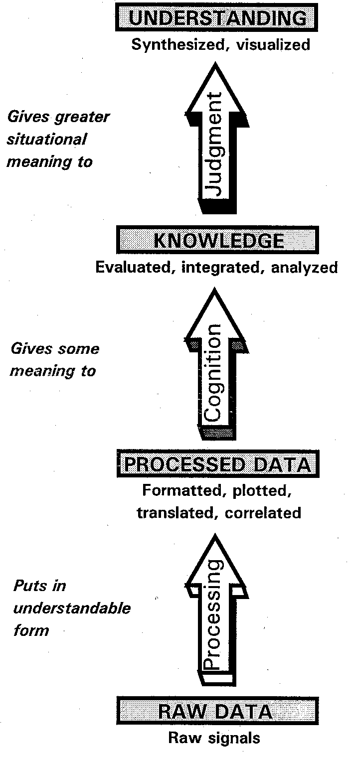
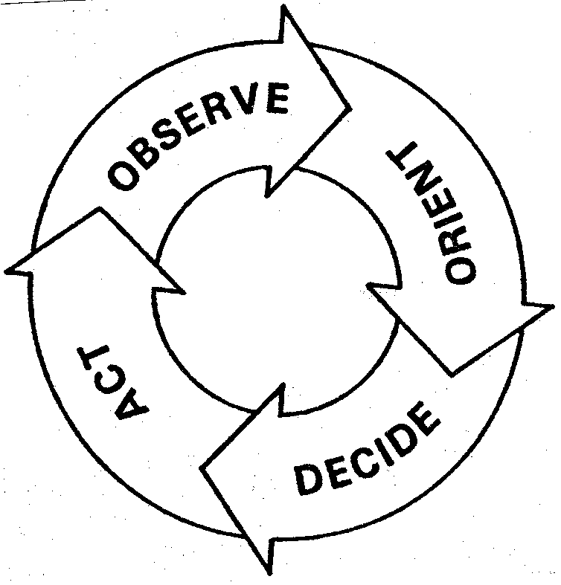
MCDP 6: Command and Control Theory
The command and control process:
The OODA loop
The information hierarchy

