Slide 1

Inmarsat Update
architectures, technologies, users
Jack Deasy
Director, UAS Programs
Inmarsat Government Services
19 July 2011

Slide 2
Agenda
Who are we?
Who are our customers?
What services do we provide?
  Space segment, ground segment, terminals
What do we do to meet government requirements?
What’s coming next?

Slide 3
Who are we? the leading mobile satellite services provider
11 geostationary satellites
Delivering range of voice & data services worldwide, on land, at sea, and in the air
  Highly secure and reliable communications
  Three generations in L-band; Commercial life into 2020’s
Financially strong with solid asset base
  Publicly traded (LSE:ISAT); Strong revenue growth:
    Group revenues 2010 $1.171B; MSS revenues $727 M (up 6.5%)
Commitment to continued innovation
  L-band position reinforced with new satellite/services
  Move into Ka-band with Global Xpress

Slide 4
Who are our customers?
Over 450,000 registered Inmarsat terminals
U.S. federal Government is our largest single user
U.S. federal, state, local agencies rely on us for :
  VIP Communications – USAF 89th Airlift Wing
  Command and control – DOJ, operational units in Afghanistan
  Air safety – USAF, DHS, UAVs
  Coalition interoperability – NATO, UN peacekeeping
  Situational Awareness – INSCOM, NASA Ames, US Fish & Wildlife; CBP
  Backup communications – State Department, NYPD, LAFD
  HA/DR – FEMA, Florida National Guard, USARMY North
  Communications for mobile teams - USDA Forest Service
Wi-Fi compatibility enables remote connectivity for everyday handheld devices

Slide 5
What services do we provide?
Voice
  PSTN-quality satellite voice
    ISATPHONE PRO
  VOIP
Data
  Legacy services (Inmarsat C, Inmarsat M family, aero )
    Data rates from 10s of kbps to 64kbps
  BGAN Family
    On demand data rates up to ½ MB
    Streaming services up to 384+kbps
Services tailored and optimized for land (portable and on-the-move), maritime and aero users
Redundancy, reliability, information assurance integrated into architecture/operations

Slide 6

Architecture: services over I4 constellation one user device, two networks
IP Network
Laptop
IP Router
LAN
Voice &
ISDN
BGAN
Earth
Station
Switch
Voice &
ISDN
Circuit Switched Network
Satellite Access Station (SAS)

Slide 7
L-band space segment
Available today
From 2014

Slide 8
Inmarsat I-4 Satellites (Narrow Spot)

Slide 9
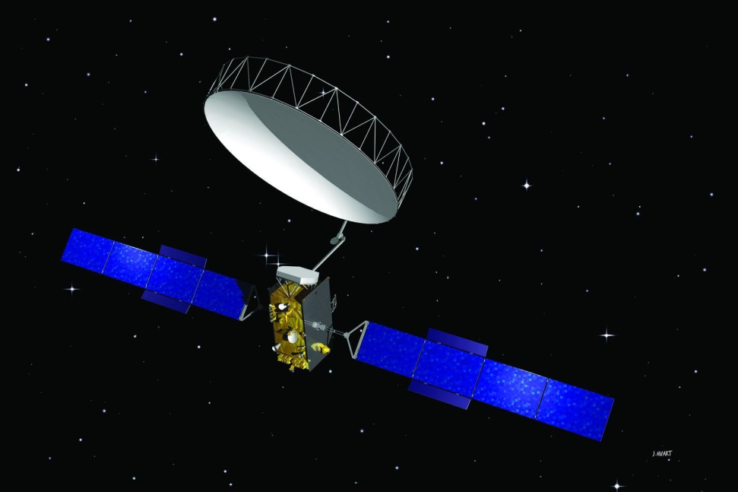
Alphasat
Our Next Launch, 2012 - 2013
Enhanced capacity over EMEA
Backed by the European Space Agency (ESA)
Advanced L-band satellite to supplement the Inmarsat I-4 constellation
  Accesses additional spectrum
  50% improvement in EIRP/G/T
  Supports 750 x 200 KHz channels
  Optimizes frequency re-use

Slide 10
Alphasat
Location: 25E (EMEA coverage)

Slide 11
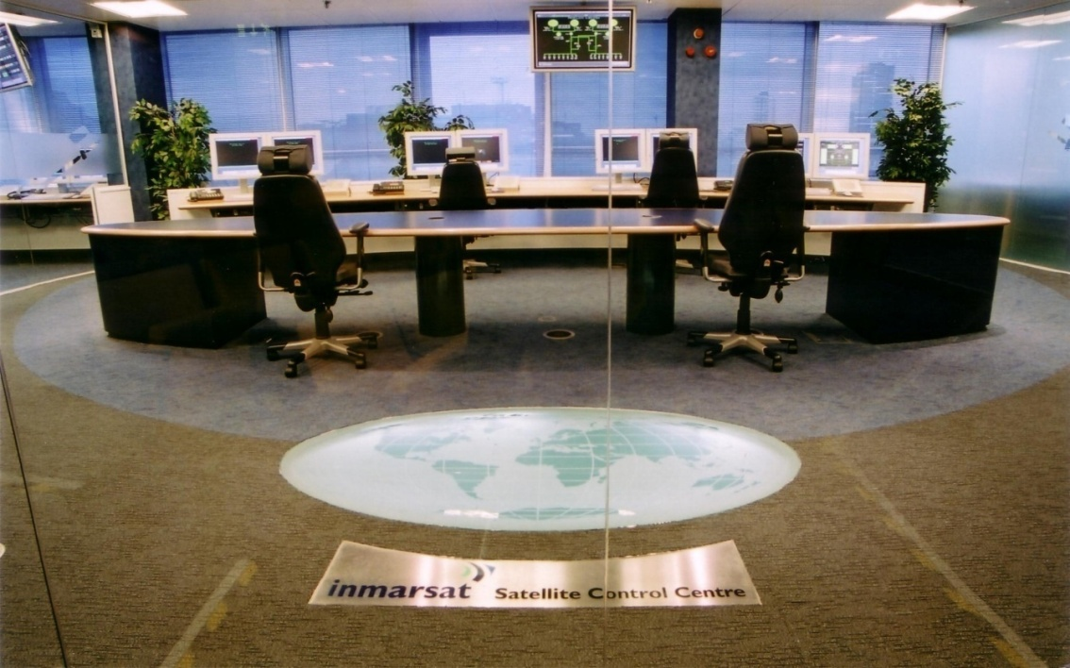
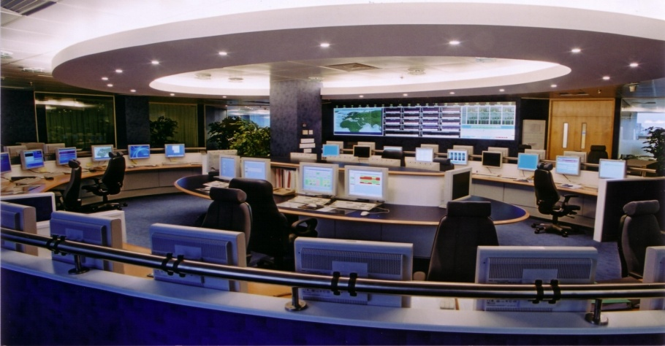
Ground Network state-of-the art control centers
Two satellite control centers (SCC) and two network operations centers (NCC)
  The main SCC and NCC are in Inmarsat headquarters in central London
  Highly secure facilities; redundant communications links
  Hot backup facilities in Burem, the Netherlands

Slide 12
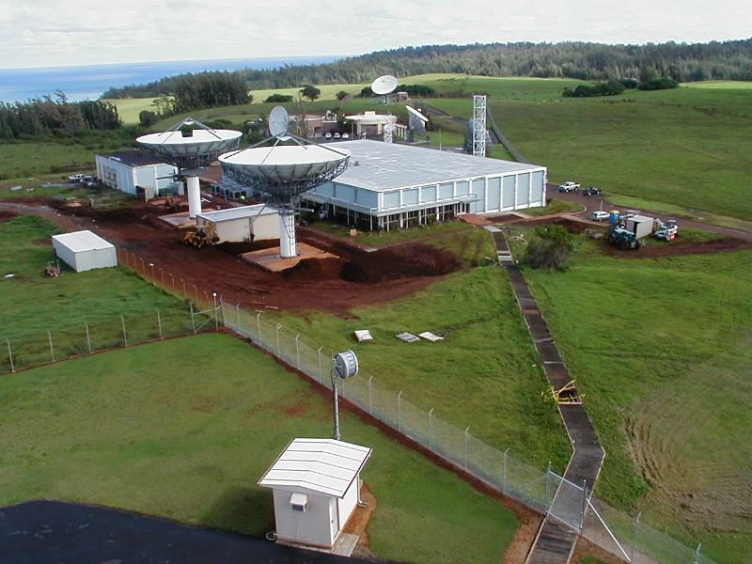
Ground Infrastructure land earth stations
Channel partners operate land earth stations for legacy services
For I-4s, SAS’s located in Hawaii, the Netherlands and Italy
SCC, NCC and SAS facilities linked by fiber network to provide full backup support
Discussions underway on direct interconnect with DOD networks

Slide 13
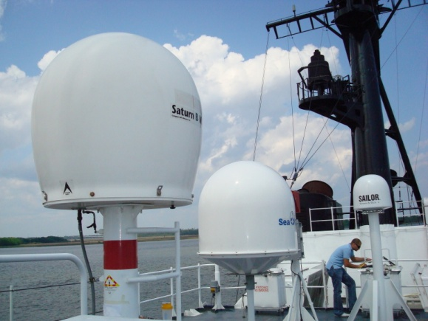
Terminals/services
Maritime

Slide 14
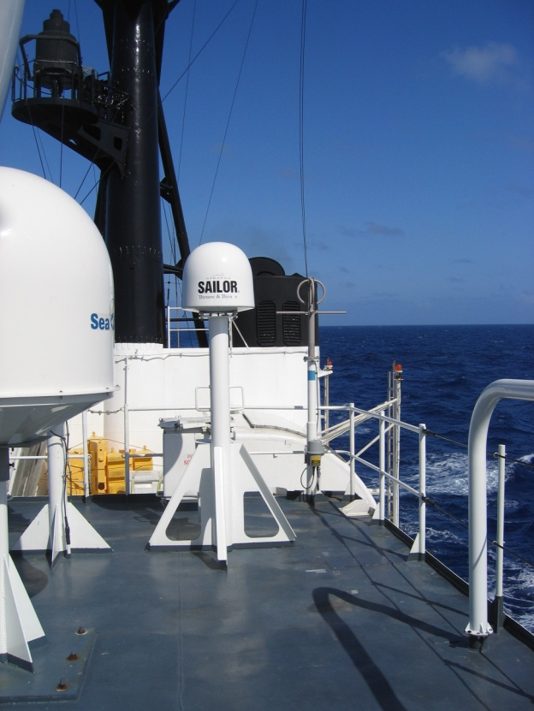
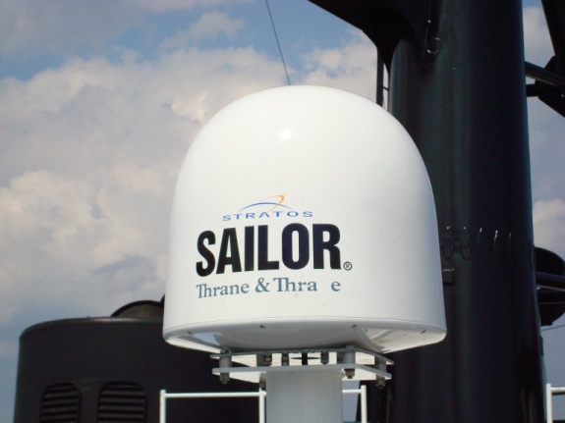
FleetBroadband (FB)
The latest generation in Inmarsat Maritime Services
Launched November 2007
Unprecedented industry acceptance
  APM-Maersk refit with FB-500, largest communications refit in maritime history
New QoS options for FB
  Expanded streaming increments
    1kbps up to 64kbps; 8kbps above 64kbps
  New 8kbps and 16kbps services required to support GSM at sea.
  More than 500 vessels equipped with GSM Picocells over Inmarsat.
Safety Services
  Full SOLAS (incorporating I-3 backup) applicable to FB-500 only; planned by end 2014.

Slide 15


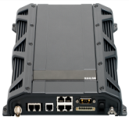
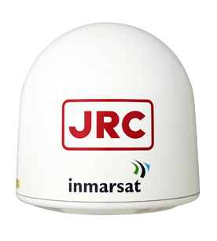
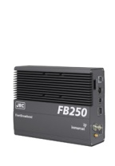
FleetBroadband (FB) Terminals
Thrane & Thrane
  FB-500
  FB-250
  FB-150
Furuno
  FB-500
  FB-250
Satlink
  FB-250
JRC
  FB-500
  FB-250
  Add Value
  FB-150

Slide 16

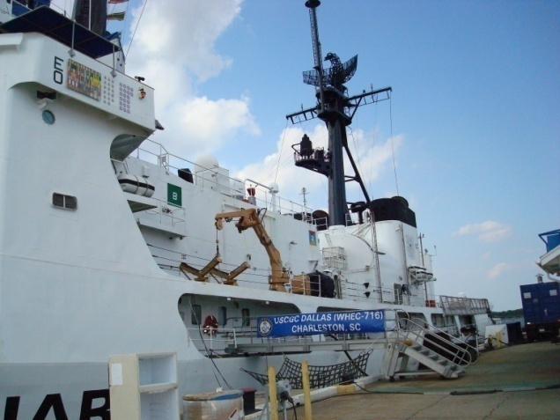

USCG Cutter Dallas (WHEC-716)
FB-500 Maritime Field Evaluation (MFE)
MFE during operational deployment (Atlantic Ocean – Mediterranean Sea)
  April – October 2008
Equipment: Thrane & Thrane FB-500
  Two day installation
    Planned five day installation accomplished in two days
Operational experience
  Up to 470 kbps
  Average 400 kbps
  Applications: SIPRNET, NIPRNET, Internet and Voice
“…flawless operations, phone clarity is very good, download speed is good, the crew is really liking this!”
8 June 2008

Slide 17
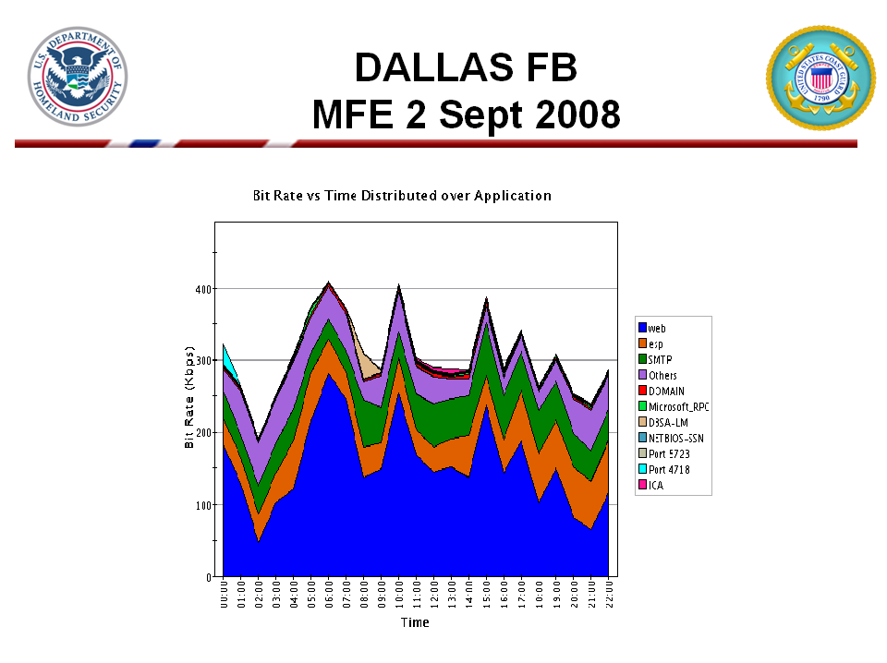

Slide 18
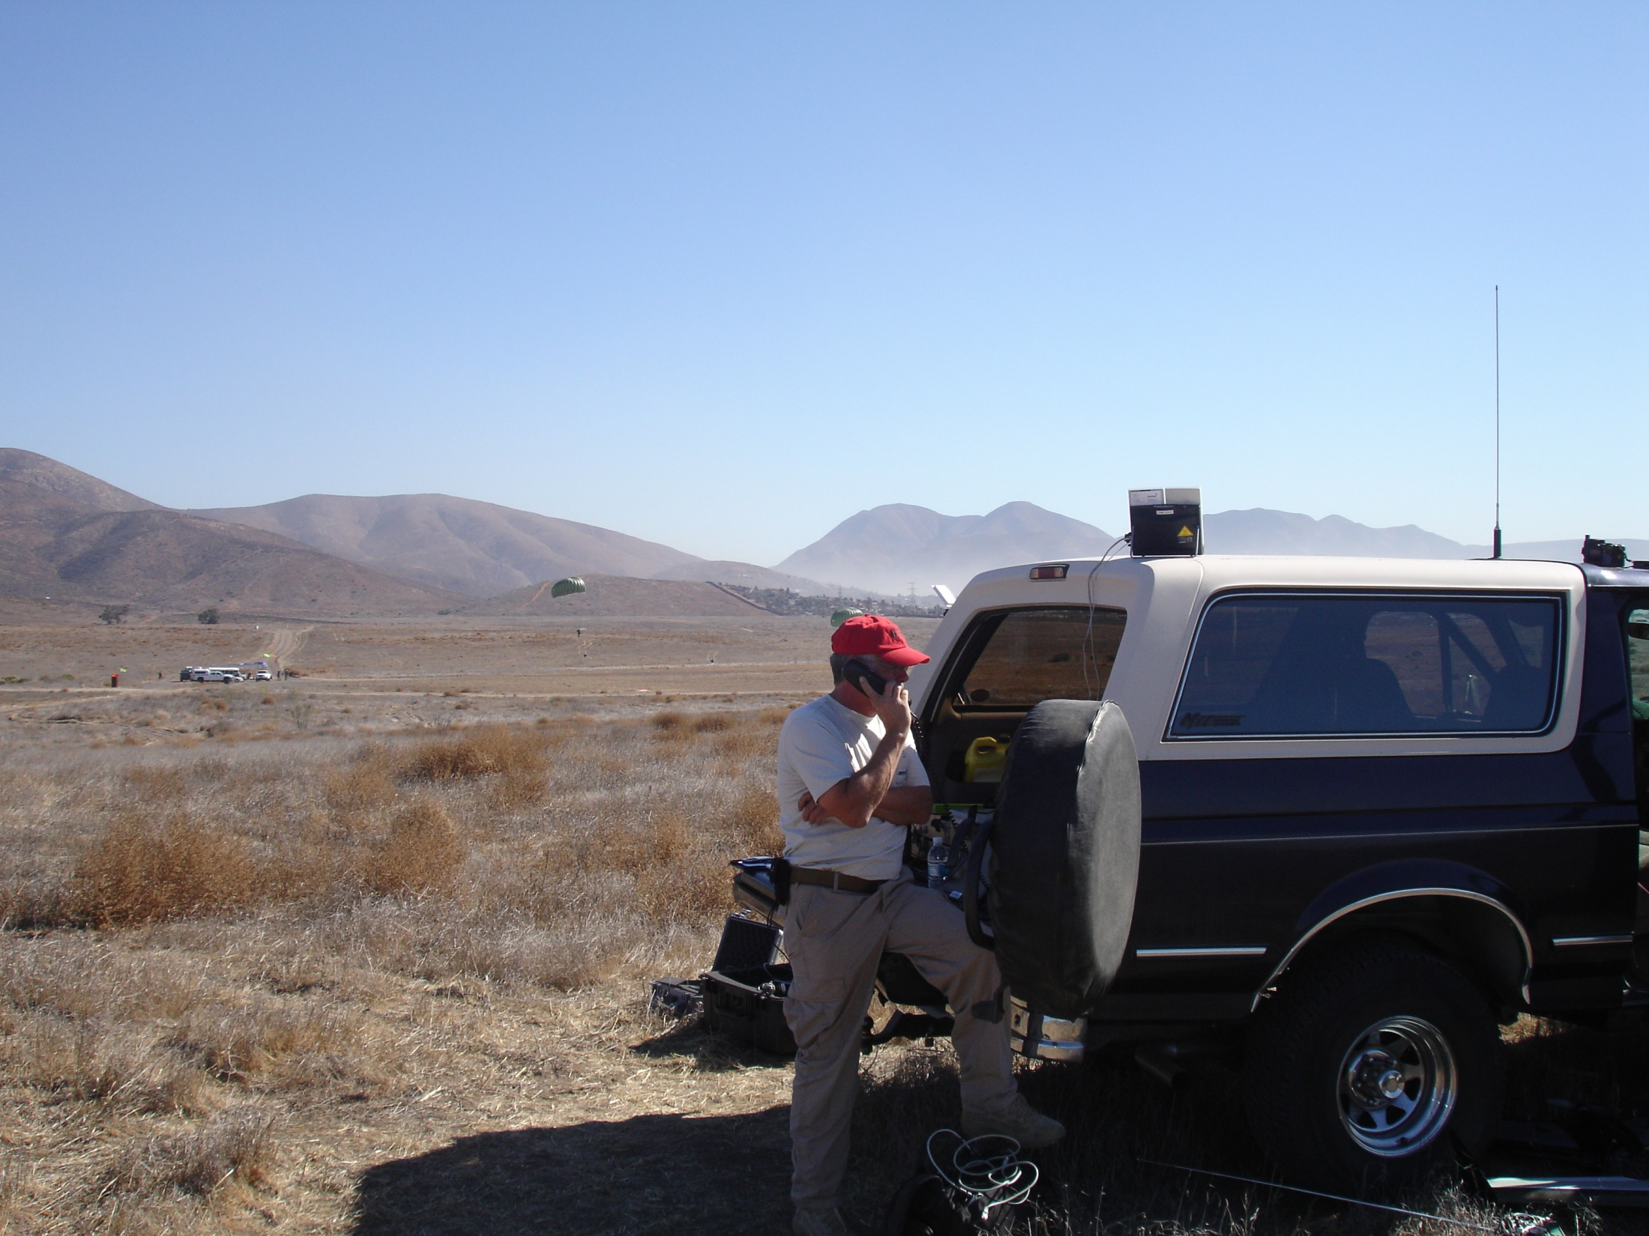

Terminals/services
Land Mobile

Slide 19

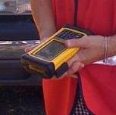
BGAN: Mobile office for mobile teams
“Exercise 24”
San Diego, Sept. 2010
HA/DR “first-in” teams can have voice and Internet connectivity from start of response
BGAN+ Wi-Fi router creates instant “hot spot”
Battery powered (36 hours standby), or remote recharging with solar panels or 12 volt car batteries
Improved on-site call security

Slide 20
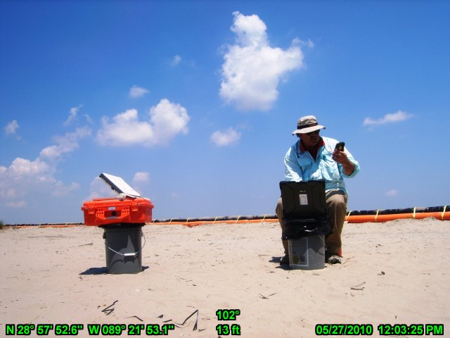

Immarsat BGAN
Deepwater Horizon Response
May/June 2009
Field data reported in near-real
time over BGAN
Notes:
I wish I had the BGAN terminal during the Victoria Bushfires. It would have also proved useful on at least a dozen other wildfires I mapped during my Government career where I had needed information with me in the field but there was a delay getting it to the incident command post due to communications availability. Even though a lot of wildfires burn in wilderness areas without adequate cellular coverage, all it takes is one good earthquake or hurricane in an urban area to turn a major city into wilderness. The Inmarsat BGAN terminal provides reliable communications anywhere in the world.

Slide 21
BGAN X-Stream Update
Global service availability since mid-2009
Class 1 terminals only (Hughes 9201 and Thrane E700)
Minimum guaranteed 384kbps upload
Verification testing in Europe, Africa and Far East; in practice found to be on average 420kbps

Slide 22
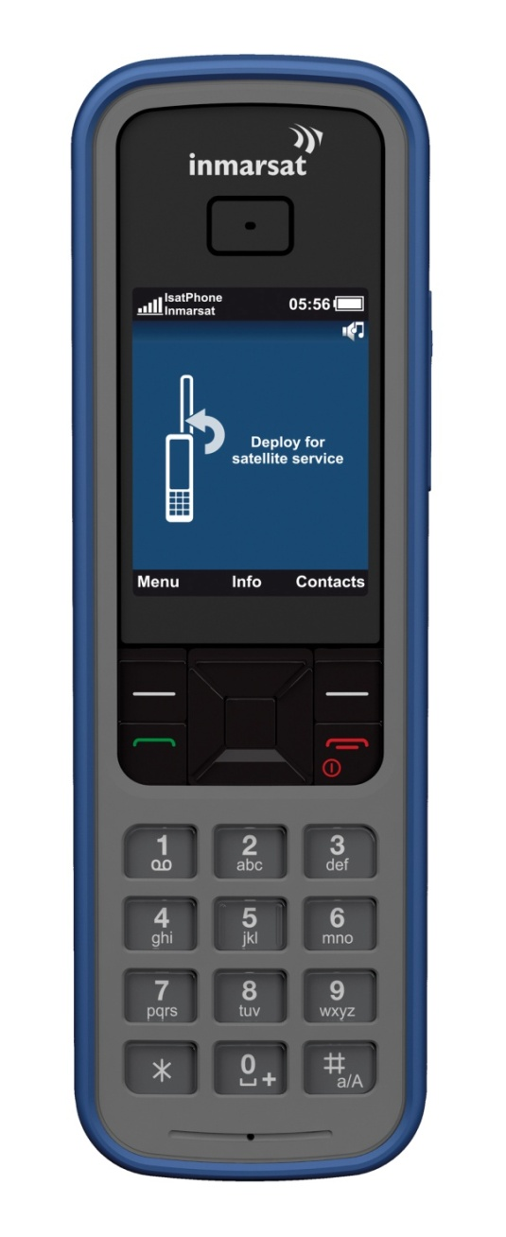
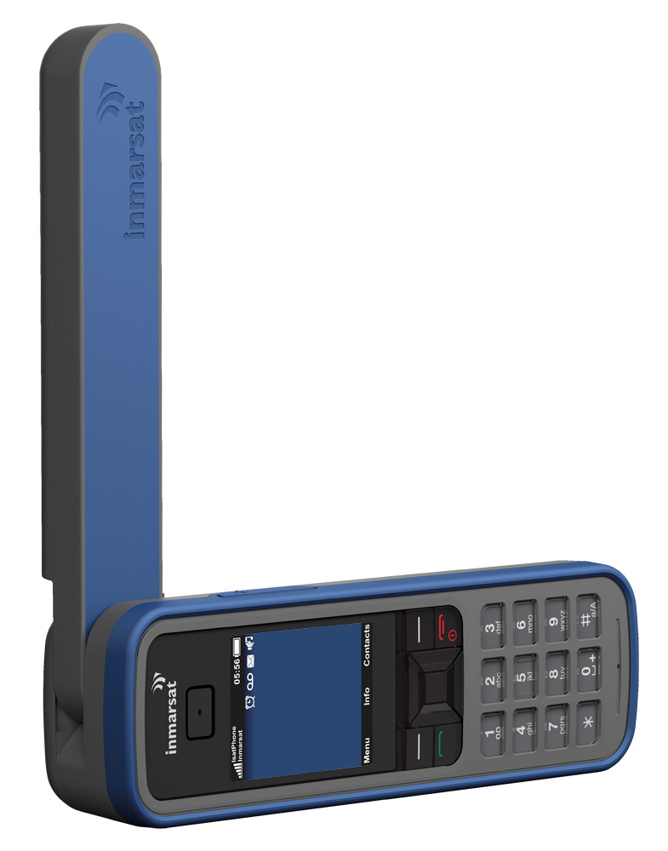
IsatPhone Pro
First Inmarsat satphone
Satellite telephony
  Voice, fax, 2.4 data, SMS, GPS
  Water and dust resistant to IP44
  Emergency voice calling
  Voicemail
  Text and email messaging
Location data – look-up and text
Bluetooth for hands-free use
Designed an optimized for I-4 network

Slide 23
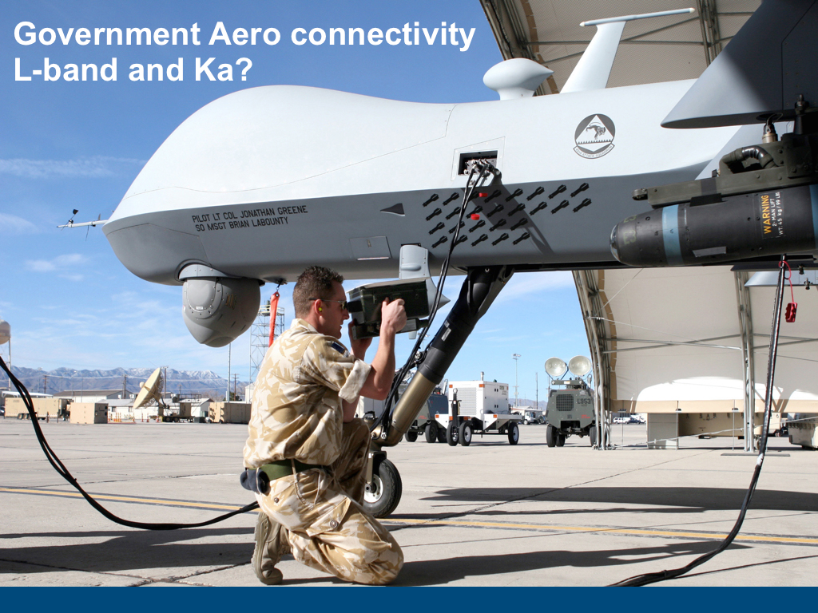
Aeronautical
Terminals/services:
aeronautical

Slide 24
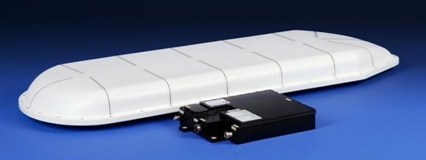
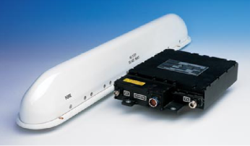
SwiftBroadband (SB)
Several manufacturers now have type-approved SwiftBroadband terminals
  Class 6 High gain
  Class 7 Intermediate Gain
Development of Services for SB Users
  Lower streaming rates available
  Dedicated channel Project Underway (SB X-Stream)
Rapidly developing sales for SB in smaller aircraft
  SBB 200
Opportunities in helicopter market for SB-based system
  Development to combat rotor effects nearing conclusion

Slide 25
Safety Services on SwiftBroadband
Inmarsat is upgrading SwiftBroadband to get certification for safety service
Oceanic Air Space Safety Services from 2014
  Meet or exceed current Classic Aero performance
  Addressing technical and institutional requirements
  Supporting existing safety apps with minimal change to avionics
Also pursuing more demanding certification for Continental Airspace:
  More stringent latency and reliability requirements
  Regular banking and turning
  Small, low-cost avionics and antenna systems required in short-haul and general aviation

Slide 26
Meeting Government Requirements
Adopting commercial solutions
  Low data rate solutions (ISATDATA PRO)
  BGAN X-stream
  Transition to IP and I-4s
Sponsored partnerships/ SB-Sat & SDR
Real world/real time demands: Haiti
Development activities to meet stated requirements
  Information Assurance
  Assured Access
Higher capacity
  L-Band
  Ka-Band

Slide 27

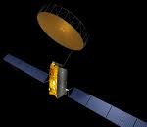

SwiftBroadband –Satellite (SB-Sat)
Inmarsat-4
Inter-satellite link
LEO with
SB-SAT
Terminal
To BGAN Network
EO Data
An unique solution to deliver real-time Telemetry, Tracking and Control (TT&C) and Mission Data from Low Earth Orbiting (LEO) satellites

Slide 28
SwiftBroadband –Satellite (SB-Sat)
concepts
Real-time delivery of LEO satellite data
Develop space-qualified SwiftBroadband terminals
SB-Sat fitted to a LEO Spacecraft links to an I-4
I-4 Satellites provide worldwide coverage
SB-Sat leverages BGAN ground infrastructure and interconnect for processing and delivering real-time data
Always-on, on demand, real-time background IP and streaming IP services
No new spectrum required; uses existing spectrum allocated to Inmarsat services.

Slide 29
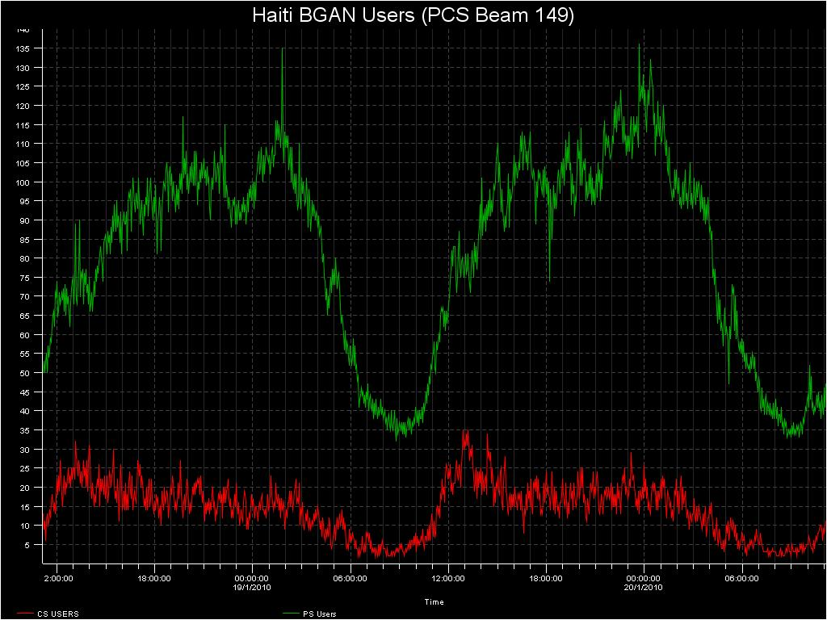
Managing a Traffic Surge
Haiti earthquake, Jan. 2010
Commercial traffic was approximately 55%
Government and NGO traffic was approximately 45%
Notes:
Special Operations
Unmanned Ariel Vehicles
Unattended Sensors
Biometrics

Slide 30

Inmarsat-5 (Global Xpress) overview
Who: Inmarsat – the trusted leader in global connectivity for 30 years
What: The only global commercial wideband Ka–band satellite system
Why: To meet the growing demands of:
  Maritime
  Government
  Energy
  Aeronautical
  Enterprise
How: Cost effective Ka-band – each I-5 has 20x the capacity of an Inmarsat-4
When: Regional in 2013, global in 2014
Boeing 702 Spacecraft
Affordable and Trusted Coverage, Speed & Capacity

Slide 31
Global Xpress – going beyond Ku-band
Higher throughput - 5M up/50M down to 60cm terminal
Smaller, better, less expensive terminals
Lower cost service
Uniform global coverage, flexible capacity allocation
Seamless mobility through a robust ground network
Access to L-band for utmost network reliability
Regional operation in 2013, Global in 2014
Supports a range of access technologies
The new standard for remote satellite communications

Slide 32
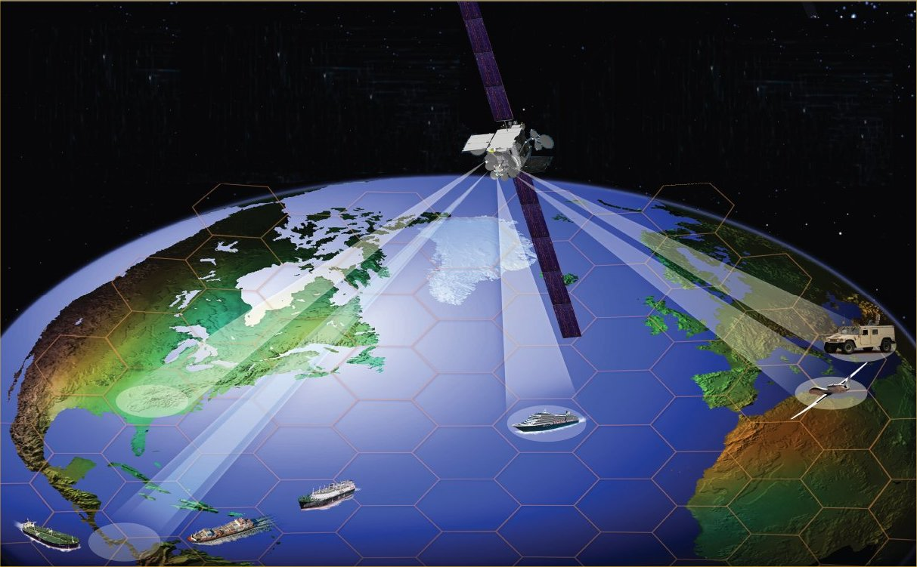
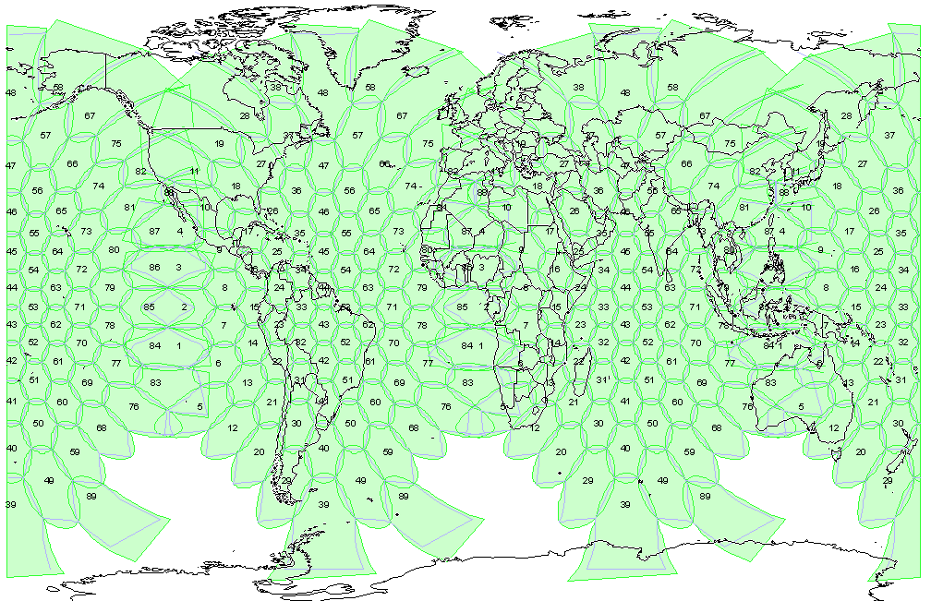
Flexibility in Space
Designed for global coverage with surge capability
Unified roaming solution – a single terminal from one provider
18 steerable High Capacity beams satisfy both long-term needs and event-driven requirements
“Inmarsat really knows how to deliver a global service”
267 Global Beams provide worldwide coverage for uninterrupted service

Slide 33
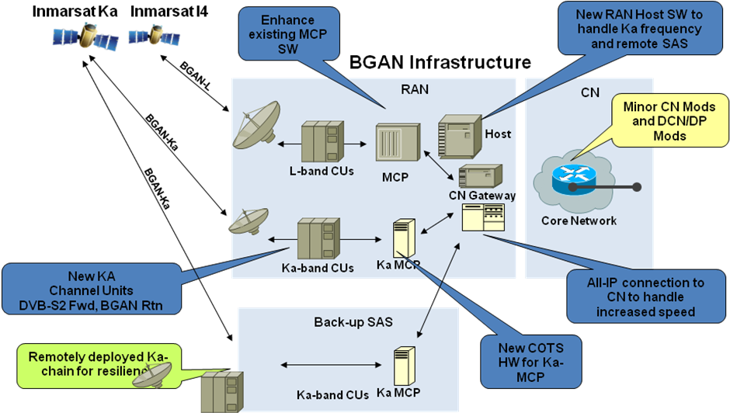
Reliability on the ground
Leverages existing Inmarsat 3G network
Ka-band or L/Ka-band hybrid services
Uniform and assured global service with diverse gateways
Supports a variety of service business models and inter-connections with customers and channel partners
Carries on Inmarsat’s reputation for QoS and reliability
“Inmarsat really knows how to deliver robust solutions”

Slide 34
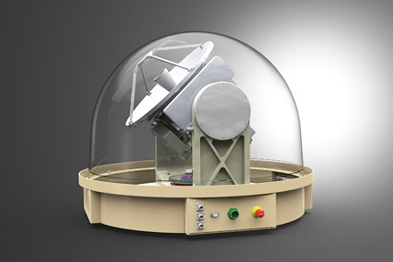
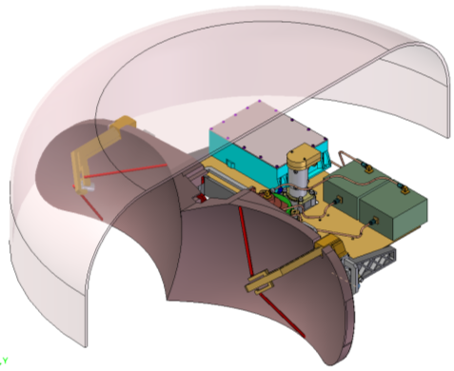
Affordability at the Terminal
Lower cost service than Ku-band
iDirect Core for consistent interface and roaming across a multi-vendor terminal ecosystem
A new standard for affordability: volume delivery of stabilized antenna terminals
  Ruggedized 60-100cm maritime units
  30-60cm aeronautical terminals
  Range of COTM & COTP terminals
Support to existing government Ka-band terminals and modems
Seamless handover to L-band
Rich terminal distribution and global network servicing & support
“Inmarsat really knows what users want in a terminal”

Slide 35
GXp summary . . .
Global Xpress will provide cost-effective, high bandwidth services whenever & wherever needed
Unique inter-operability of I5’s and I4’s provides:
  Robust worldwide coverage with hot-spot capability
  Economical delivery of services while in transit and on-station
  Ensured communication operations even in adverse environments
Highly flexible ground and network infrastructure including:
  Robust, diverse network architecture
  Highly secure gateway segment
  Support to standard and user-defined waveforms and terminals
Now is the time to plan for GX in your future network

Slide 36
Summary: what’s ahead
Enhanced capacity/throughputs with Alphasat
Enhanced data throughputs on BGAN family
Continued commitment to safety services: SBB safety oceanic safety services starting 2014
SBB helicopter waveform
New low data rate products
Transition to IP-based BGAN family
Transition of services to I-4 constellation with life into 2020s
Continued commitment to L-band services
New Ka-band constellation
Inmarsat – a commitment to innovation to meet the
evolving needs of the government customer

Slide 37
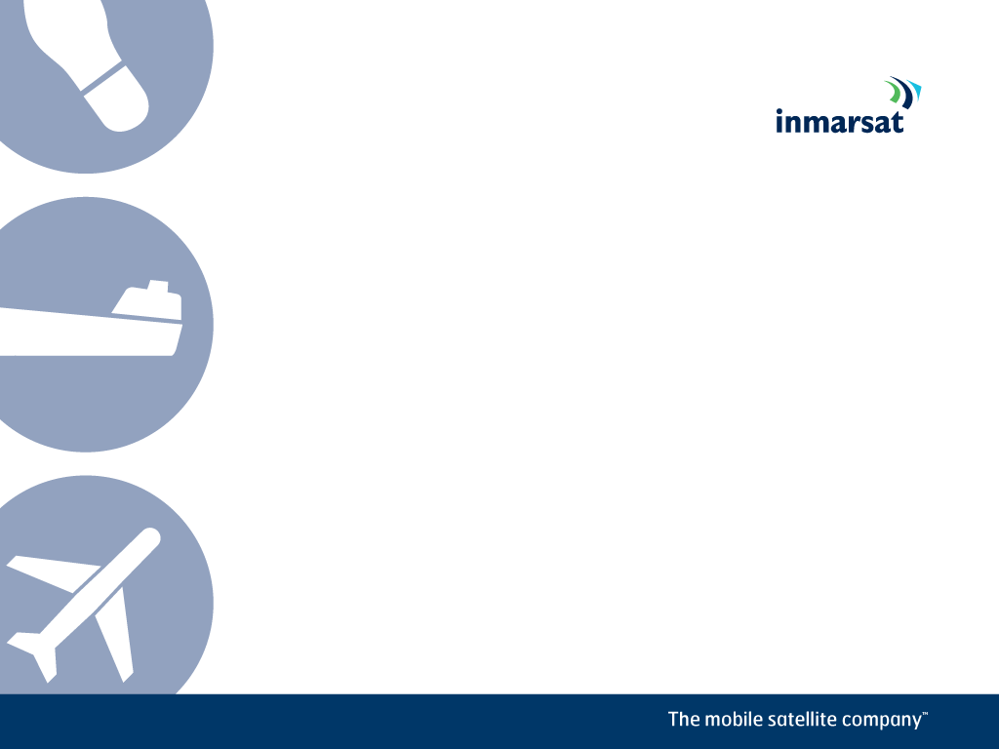
Thank you!
Jack Deasy, Director, UAS Programs
jack_deasy@inmarsat.com
Mobile: +1-336-541-0938

