Slide 1
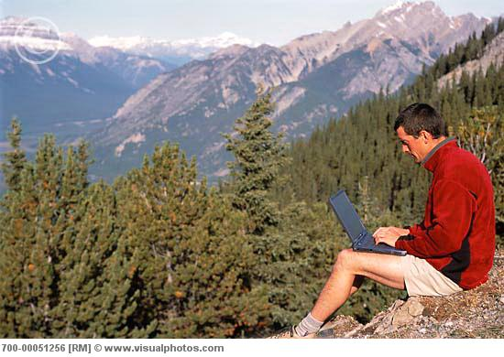
Enemy in the Wire(less):
T&E Perspectives on Wireless Security
Brief for the Naval Postgraduate School Wireless Technology Forum
David J. Aland
19 July 2011

Slide 2
US v. Ardolf
Barry Ardolf hacks his neighbor’s WEP-protected wireless home network in retaliation for police complaint
“Certified Ethical Hacker”, Internet technician for MedTronic
Downloads and uses “AirCrack” to reduce WiFi passwords
Creates fake accounts tied to victim identity, social network sites
Sends porn, nasty emails, and death threats against VP Biden in his victim’s name with dire results for victim
NOT caught by Secret Service or police
Caught by a private security company
GUILTY in Federal Court
18 years in prison
no computer use until released
20 years probabtion after release.

Slide 3
Hackers v. Wireless
Thomas Roth, University of Koln, Germany
Rents space on the Amazon Elastic Computer Cloud for $0.28/min
Generates 400,000 brute-force passwords per second
Breaks WEPs, averaging 6 min (approximate cost = $1.68 / network)
CryptoCard, UK
Sends testers to coffeeshops to set up bogus WiFi hotspots
Captures an average of 350 usernames/passwords per hour
Navy Research Lab, Washington DC
During BETA test of wireless discovery tool (with GPS/Google Maps), discovers internet thieves stealing wireless cash register data
News of the World, UK
Hacks cell phones of celebs, politicians, 9/11 victims
:

Slide 4
Exercise IA Assessments
DoD conducts IA assessments during major exercises with the support of the operational test agencies and the Information Warfare Centers
ATEC, 688TES, COMOPTEVFOR, MCOTEA, JITC
1IOC, 24AF, 10TH FLT, MCNOSCC, NSA
`20-25 exercises per year at COCOMs and Services
Results are aggregated and analyzed for enterprise level issues and recommendations
“Smoking Gun” issues are sent as formal findings to cognizant Service or Agency at the 3-star level
Annual trends are reported to DoD and Congress

Slide 5
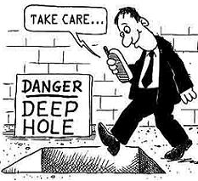
Wireless and Mobile Tools
Exercise assessments show three major issues with operational proliferation of common wireless/mobile tools:
Physical accountability and TEMPEST controls
Loss of physical control over a device loaded with sensitive data
Loss of CAC card and device credentials
Signal monitoring (quantity and quality)
Environmental Masking of effects and vulnerabilities
Only the most austere environments are wireless-free
Urban combat environments are wireless-dense
Stupid human tricks
Storing and transmitting PII or sensitive data
“Pretending” the device is secure
Cross-infection techniques

Slide 6
To Secure or Not To Secure
The majority of wireless/mobile devices in use in operational environments are not secure or meant to be
Secured wireless devices like SME-PED are rare
Therefore … the principal security problem is NOT:
Type I or Type II encryption
Multi-Level Security
Suite B compliance and effectiveness
The principal security problem is that unsecured wireless/mobile devices are cheap, ubiquitous, and highly functional , and often misused

Slide 7
Technology is not the whole answer…
Better device security is a MUST
Wireless devices will not just “go away” because they are tough to secure.
Functional standards are needed as badly as technical standards
The first device to market may be attractive, but the competitor catch-ups are usually better provisioned
The device maker must have an incentive to build in safeguards that can be re-purposed for specialized security environments
Device management cannot be “iSourced” out or untouchable
An operational doctrine of Perishability should be applied to their use: handle data only appropriate to that level of operations, and only handle perishable data on portable devices

Slide 8
Conclusion
Wireless mobile devices are here to stay (at least until we invent something even better)
Wireless mobile devices provide an undeniable tactical advantage to combat forces as well as enviable convenience to senior decision makers
Wireless mobile devices provide an almost indefensible vulnerability to any user, regardless of technical profile
Use of perishable frequencies, “thin client” devices (Tech) as well as transitory information practices (SOP) can make the security technology gap less dangerous
If speed is why you have a mobile device, use it to your advantage!

