Slide 1
Least Privilege Separation Kernel (LPSK)
Accomplishments and
Current Work

Slide 2
Outline
Why are we talking about this here?
What is a separation kernel?
What is the LPSK?
Progress with the LPSK
Future work
Demo

Slide 3
Digression…
I think PowerPoint (and its ilk) are greatly misused.
Therefore…

Slide 4
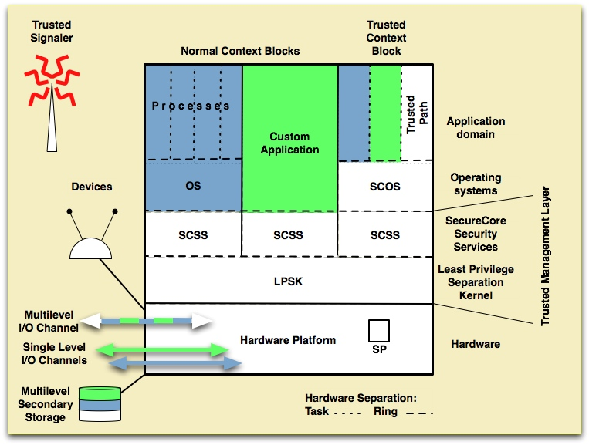
What is the relevance?
Notes:
Many years ago, my research group envisioned a hand-held device (prior to iPhones), like a PDA, that could be used by first-responders.

Slide 5
What is a Separation Kernel?
OS
Security Kernel
Separation Kernel
Notes:
OS
* Provides generalized services that processes need.
Security Kernel
* Roughly, that portion of the OS that enforces security policies
* For high assurance, it resides in a separate execution domain (isolation)
Separation Kernel
* Partitions all system resources into “equivalence classes” (e.g., classifications)
* Controls information flows between partitions (as configured)
* Enforces whatever policy it is configured to enforce.

Slide 6
Partition Flow

Slide 7
As a VMM
OS #1
OS #2
OS #3
OS #4
Separation Kernel

Slide 8
Separation Kernel Protection Profile (SKPP)
Notes:
CC requirements developed for NSA by NPS and MITRE
Security requirements for “high robustness” separation kernel ~ EAL6+
Completed in 2007
Green Hills evaluated against it
Others claim compliance with it
Being retired by NSA

Slide 9
Least Privilege Separation Kernel (LPSK)

Slide 10
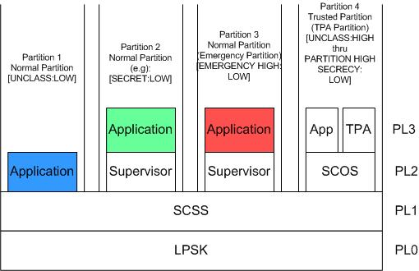
Phase 1 LPSK Architecture

Slide 11
LPSK Config (1)
Audit
Enabled?
Size of internal audit buffer
Action when audit is full
Run-time LPSK
How shall kernel use the screen?
Reserved memory locations

Slide 12
LPSK Config (2)
Partitions
Round robin duration for all partitions
For each partition
Active?
Percent of round robin duration
Percent of system RAM
Partition with initial I/O focus
Partition to handle SAK

Slide 13
LPSK Config (3)
Partition flow rules
Processes in Partition ‘x’ can access Partition ‘y’ (RO or RW)
Acyclic flow rules

Slide 14
LPSK Config (4)
Imported files from disk
Location on disk
Home partition
Assigned PL
Audited events

Slide 15
LPSK Config (5)
RAM segments
Size
Home partition
Assigned PL
Audited events

Slide 16
LPSK Config (6)
Devices
Data channel or control channel
Home partition
Multiplexed or dedicated
Device specific attributes (e.g., keyboard buffer size)
Audited events

Slide 17
LPSK Config (7)
Processes
Home partition
% of partition time slice
Subject defintions
Code location and PL assignment
Kernel APIs allowed to use
Subject-to-resource flows allowed
(e.g., subject x can access device y)
Audited events

Slide 18
Funded Objective

Slide 19
Progress Report
Notes:
Boot problem
SATA disk driver (PATA, tested, limitations, tech report)
NIC support phase 1 (no std, no doc, AMD, VMware)
NIC support phase 2 (Broadcom 5764, common, doc)
Students
Audit
Config tools
IP stack
Application support (clib, FAT RAM disk)
Emergency handling (state transitions, analysis of protocols)

Slide 20
What the Prototype has now
Kernel config options
Multitasking processes
Segmented memory
Device drivers for:
Disk drives (PATA/SATA)
Hardware clock
Software clock (low res)
Video (text mode)
Keyboard (PS/2)
Configuration security policies
Inter-process communication using:
Eventcounts
Sequencers
Signals
Shared memory
Kernel event auditing
I/O focus switching between processes

Slide 21
Outside the LPSK
Notes:
PL1
Ethernet frame parsing for some protocols
Keyboard scancode-to-ASCII mapping
PL2
Console support (echo and line scrolling)
I & A (login)
PL3
Partial standard C library support
Several example applications

Slide 22
Future Work
Notes:
Implement additional configuration options
Drivers
Finish SATA driver
Finish the AMD and Broadcom NIC drivers
Write additional NIC drivers (e.g., 3com)?
Write a USB driver (student)
Write a USB keyboard driver
Write a video driver? (graphics)
Work on the functional specification
Complete the TCP/IP stack
Implement an audit review app
Support more than one process per partition

Slide 23
Demo

